Slide 1
Non coding regulatory variants in Myelosuppression toxicity in 96 whole genome sample cohort
Sailendra Pradhananga

Slide 2
Aim of project
Annotate variants with publicly available database such as ENCODE, FANTOM5
Prioritize variants based on machine learning methods in each cell types
Validate prioritized variants using orthogonal technologies

Slide 3
Preliminary analysis
Intersect between Passed/lowcomplexity variants with different non coding functional units
Annotate with Histone markers, transcription factors from ENCODE project
Annotate with FANTHOM project
For different cell types

Slide 4
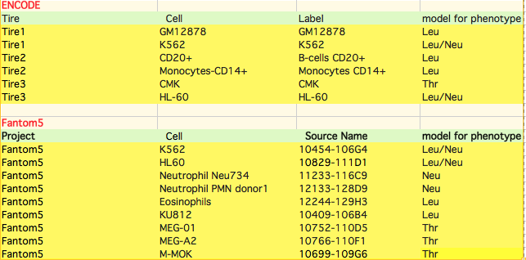
Different Cell type for different phenotype mode

Slide 5
GM12878 cell type
ENCODE and FANTHOM data
Lymphoblastoid cell line from blood
Mesoderm cell lineage
Used as model for Leucopenia
“Idea → Optimize analysis in this cell-type and scale up for other cell types”

Slide 6
Preliminary analysis
Intersect variants present in individual functionally annotated units and variants
Metrics of intersection→ Jaccard index
Used to compare similarity between sample set
Value between 0 and 1

Slide 7
Intersection between individual histone markers and whole genome sample
Histone modification ?? Does it change within the genome or chemically modified??

Slide 8
TF Jaccard index for GM12878

Slide 9
Transcription factor GM12878
390283 variants TFs
106102 Singleton
284171 Shared alleles

Slide 10
Analysis strategy
Used frequency from Sweden 1000G sample
Subset variants that are present in higher frequency in sample than 1000G
Prioritize variants based on common and rare allele frequency from Swefreq cohort
Get read count status based on FANTOM5 dataset

Slide 11
Pass and LC VCF
Annotate variants with Swe 1000 data
Pass/LC/1000GSwe Variant
Subset variant into common and rare based on MAF 0.05
Rare variants
Common variants
Combined set of ENCODE TF/histone modification markers GM12848…
Annotate variants from ENCODE GM12848 cell line
ENC -TF/ENHANCER RARE VARIANTS
ENC-TF/ENHANCER COMMON VARIANTS
FANTOM5 DATASET GM12848
Annotation with FATHOM5 DATASET
FAM-ENC TF/ENHANCER RARE VARIANTS
FAM-ENC TF/ENHANCER COMMON VARIANTS

Slide 12
Some statistics in our passed SNP variants
Variants in toxicity cohort passed and low complexity removed | 11805808
Total number of variants present only in 1 individuals | 3048914 (25.82%)
Singleton/private variants in our cohort SNP (het) | 2992133 (25.34% )
Variants present only in 1 individual (homo | 56768 (0.48%)
Variants shared at least by 2 individuals | 8756894 (74.17% )
Variants in 1000G_Sweden 30663042

Slide 13
SwedFreq vs Sample Cohort
Total number of variants in both dataset | 10627209
Variants present only in sample cohort | 1178599 (11.09%)
dbSNP (137) variants in our sample cohort | 222538 (18.88%)
Variants exclusively present in our sample cohort | 956061 (8% of total variants)

Slide 14
SNP Variants exclusive to sample cohort
SNP exclusively present in our sample cohort | 956061 (8% of total variants)
Variants present in one individuals | 885545 (92.62 %)
Singleton het variants | 871930 (91.20 %)
Single Homo mutant variants | 17335 (1.81 %)
Variants shared by 2 individuals | 70353 (7.35 % )
7 % of the novel variants present in our samples are shared by at least 2 of individuals
Genomic regions that are unique in this region ..
Rare variant overrepresnted to some functional regions

Slide 15
Rare and Common variants
Subdivide Pass variants into common and rare with AF from Swed1000G.
Use standard MAF of 0.05
5890015 (49.89%) --> Common
5915793 (50.10%) --> Rare

Slide 16
Annotation with histone modification and transcription factor in GM12878
Previously , we have intersected downloaded all the TF and histone modification bed files from ENCODE
We intersected for individual transcription factor with our Passed/SNV list
And combined together to get a set of TF/histone regions in our sample cohort

Slide 17
8180377 SNV variants annotated
4046058 (68.63%) Common variants
4134319 (69.88 %) rare variants
Quite high numbers as compared to TFs only which was 185230(3.14%) and 205053 (3.46%) respectively

Slide 18
Further, Annotating with FANTOM5
Downloaded and subsetted data to GM12878
58880 regions were reported for GM12878
Bedtools intersect to find the overalpping regions
3393 common and 5725 Rare SNVs annotated with ENCODE and FANTOM 5 datasets

Slide 19
Allele Frequency in sample and Swed Freq cohort
Here we observe that some variants present in higher frequency than in swed 1000F. However, these are false positive as they have reported in website that that they have missed freq of ome variants

Slide 20
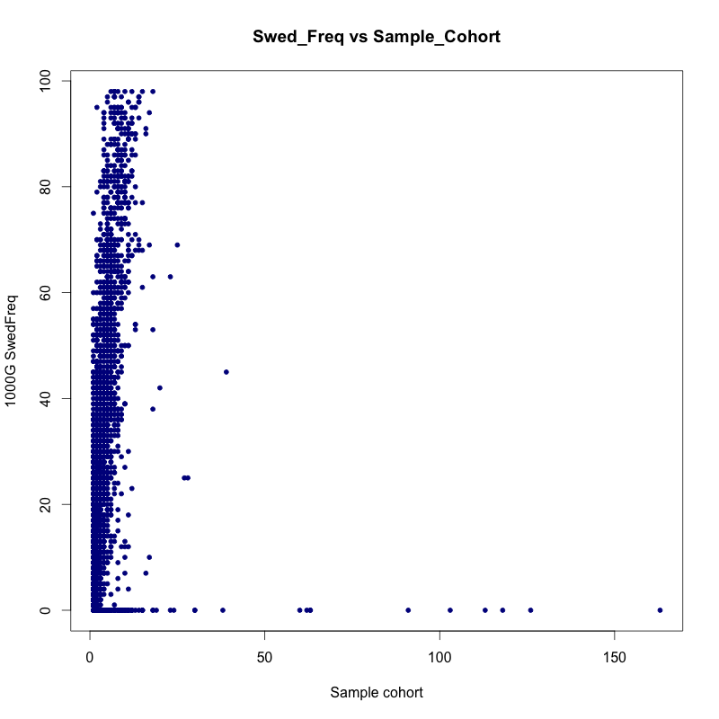
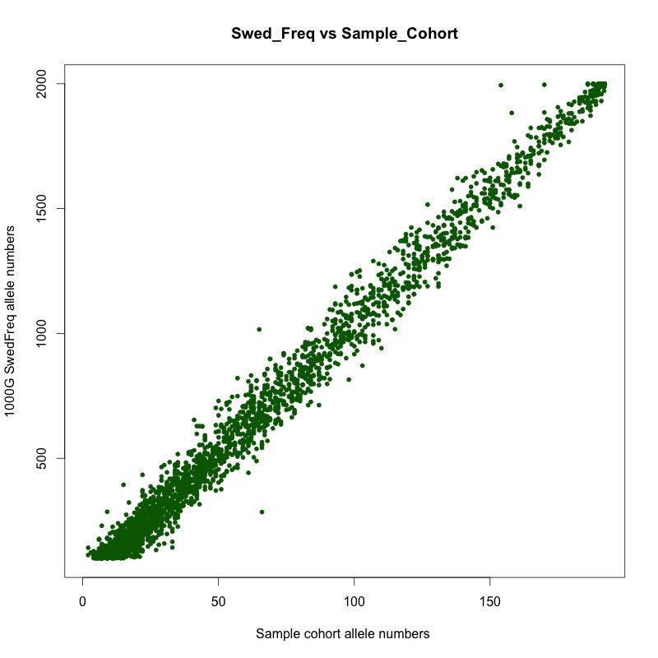
Similar observation made with allele count

Slide 21
DNaseI signal
Histone marks to overlap H3K4me1, H3K9Ac
FANTOM expression
TF binding
01015, 0000, 11120, 00010
Classification of variants
Common >=5%
Less common >=0.1% and <5%
Rare <0.1%

Slide 22
Classification of Variants
Common, Low frequency and rare variants
Ionita-Laza, Iuliana, et al. (2013)
Basic premise classification: Low frequency variants potentially are interesting ones but we are not excluding any variants from our study
T = 1/√2n
n = number of individual in study

Slide 23
Classification of variants in sample
Considering given sample size of 1000 in SweFreq
Classified variants into three groups
- Common variant (MAF) > 0.02
- 0.02 <= Low frequency > 0.001
- Rare vairant <= 0.001

Slide 24
New Variant counts in each group
Sub groups | Numbers
Common variants | 7,120,923 (60.31%)
Low Frequency variants | 2,901,254 (24.45%)
Rare Variants | 1,783,631 (15.10 %)

Slide 25
Annotating each variants with different ENCODE and FATOM5 data
Relevant cell types from ENCODE annotated
- DNAISE- hypersensitivity
-Histone marks for poised enhancer and active promoters ; H3Kme4 and H3K9Ac
-FANTOM 5 CAGE expression data
-Transcription factor binding sites (TSS)
Note: only GM12878 and K562 were annotated with all
DNA elements.

Slide 26
Comparing annotated cell lines
GM12878
B-lymphocyte,
lymphoblastoid
K562
Leukemia cell line
Both are Tier 1 cell lines in ENCODE and have CAGE expression profiles from FATHOM 5

Slide 27
Annotated SNV count for each functional elements
Cell type | DNAseI HS | Histone marks | Overlapping FATHOM 5 | Number of TFs | Overlapping TF binding sites
K562 | 136,213 | 3,289,205 | 6,305 | 98 | 403,298
GM12878 | 121,075 | 1,709,964 | 12,781 | 73 | 390,283

Slide 28
Annotated SNV count in different variant categories
Cell-type | Total NC- ANN features | NC-ANN Common | NC-ANN Low freq | NC_ANN Rare freq
K562 | 3,429,808 | 2,027,386 | 865,272 | 537,150
GM12878 | 1,834,449 | 1,072,818 | 467,122 | 294,509

Slide 29
Cell type | Overlapping DNAseI HS | Overlapping Histone marks | Overlapping FATHOM 5 | Number of TFs | Overlapping TF binding sites
K562 | 136,213 | 1,920,252 | 6,305 | 98 | 403,298
GM12878 | 121,075 | 1,709,964 | 12,781 | 73 | 390,283
CD20+ | 74,723 | 1,282,537 | - | - | -
Mon-CD14+ | 92,522 | 1,427,523 | 12641 | - | -
CMK | 91,622 | - | - | - | -
HL-60 | 106,273 | - | 5,811 | 1 | 19,024

Slide 30
Cell-type | Total NC- ANN features | NC-ANN Common | NC-ANN Low freq | NC_ANN Rare freq
K562 | 3,429,808 | 2,027,386 | 865,272 | 537,150
GM12878 | 1,834,449 | 1,072,818 | 467,122 | 294,509
CD20+ | 74,723 | 42,315 | 19,919 | 12,489
MON-CD40+ | 1,445,273 | 850,801 | 365,498 | 228,974
CMK | 91,622 | 52,149 | 24,219 | 15,254
HL-60 | 118,441 | 67,084 | 31,408 | 19,949

Slide 31
General recap
In earlier, presentation we talked about annotation in different cell types.
However we would like to have an aggregate analysis in all of cell types.

Slide 37
Annotation with Gencode protein-coding regions
Following non-coding gene annotation
Biotype annotation from Gencode database V19
Different type of annotations→ lincRNA, miRNA, pseudogene, intergenic, antisense and protein-coding regions.

Slide 38
Why bother with these annotations??
To find out which markers have high importance in our data
For example, what can we do of variants with potential only one non-coding DNA elements
Further delve into Non-coding elements

Slide 39
Psedudogenes and Intergenic variants
Pseduogenes are often have multiple mutations
Treat it as negative control
Compare it with Intergenic variants
Find which is enriched in these regions

Slide 40
Snapshot of variants genecode in GM12878 (Protein_coding Common)

Slide 41
Overlapping DNA elements in low frequency variants in GM12878

Slide 42
Overlapping gencode and Noncoding markers in rare variants

Slide 43
Enrichment status in Common GM12878
No significant rnrichment seen in any of the DNA elements

Slide 44
Thus we have…
To devise and prioritize variants based on low and high toxicity
Similar to earlier analysis
Cluster each variants in high and low toxicity for each phenotype and combined phenotype

Slide 45
Taking all the phenotypes at K=2
Visuallization of Clustering of Patients into two groups
Scree-Plot for the clustering analysis
No clear elbow points seen so
K=2,3 ….

Slide 46
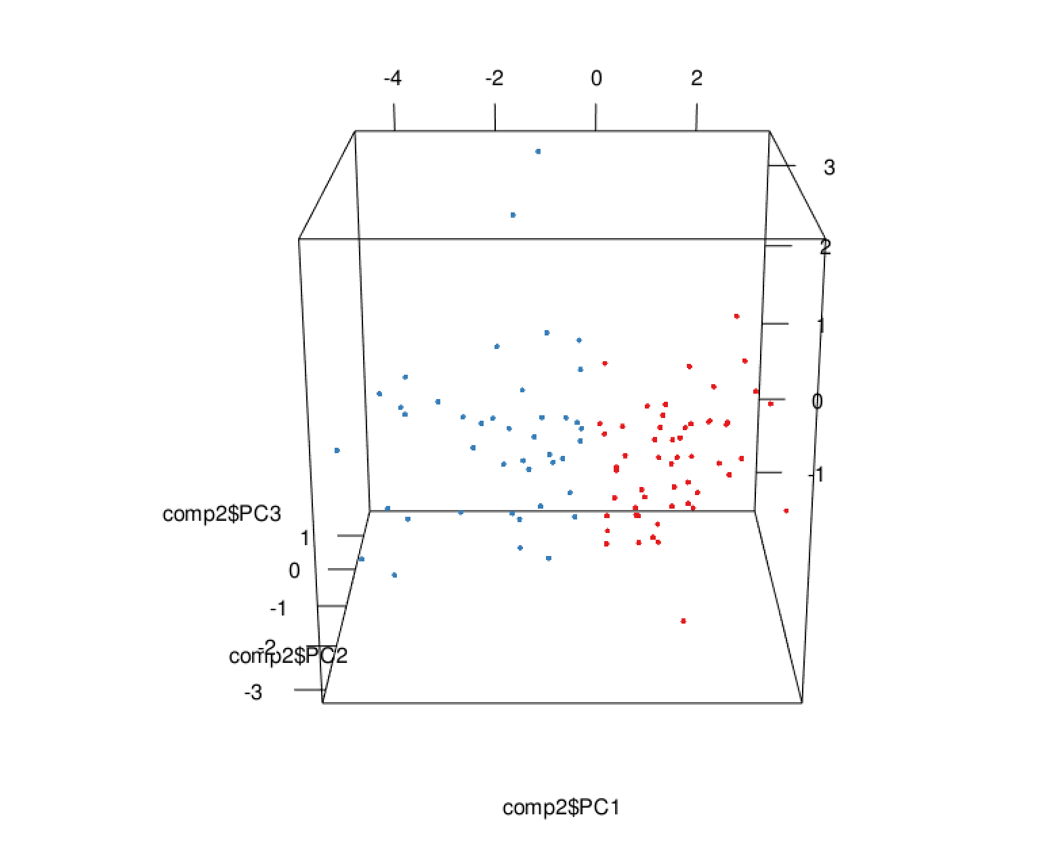
Also seen in 3D plot

Slide 47
Clustering results
Using unsupervised Kmeans clustering at K=2
HT | LT
54 | 42

Slide 48
For the individual phenotypes TPK at K=2
Clustering results | Original Labels in CTC
 | 0 | 1 | 2 | 3 | 4
1 | 27 | 9 | 2 | 0 | 0
2 | 0 | 3 | 12 | 23 | 20
Not good clustering results as before
As information is missed now
However it seem to able
to cluster low toxicity groups
LT (1) | HT (2)
38 | 58

Slide 49
LPK at K=2
Clustering results | Original Labels in CTC
 | 0 | 1 | 2 | 3 | 4
1 | 28 | 1 | 0 | 0 | 0
2 | 11 | 6 | 22 | 24 | 4
HT (2) | LT(1)
67 | 29

Slide 50
NPK at K=2
Clustering results | Original Labels in CTC
 | 0 | 2 | 3 | 4
1 | 39 | 2 | 0 | 0
2 | 5 | 4 | 18 | 28
HT(2) | LT(1)
55 | 41

Slide 51
Thus,
Thus, may be at K=2 ,
It would be hard to distinguish High tox cluster
Try at different cluster and observe results
Add toxicity information to the variants and prioritize variants

Slide 52
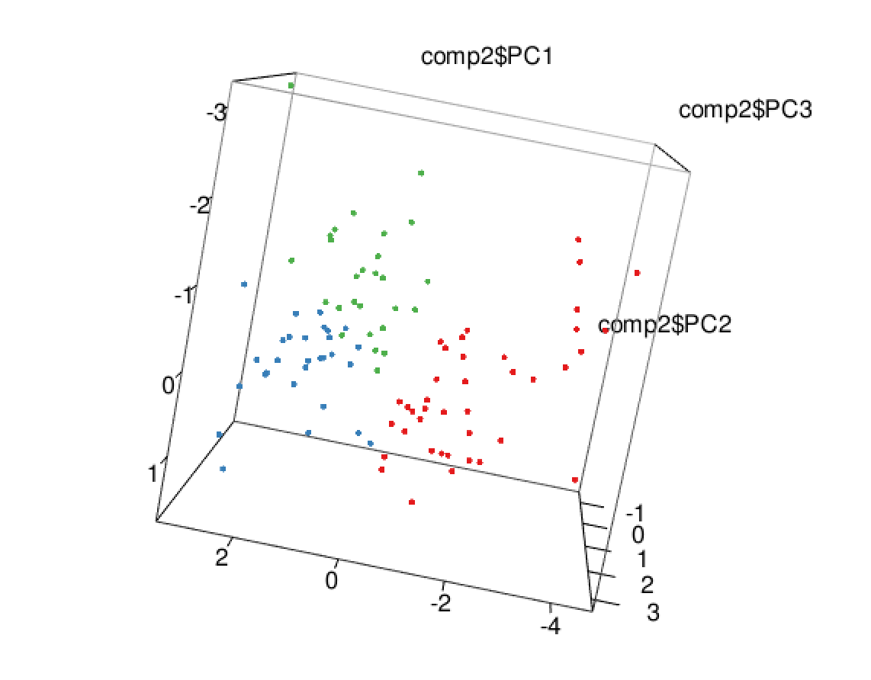
At K=3; for all the phenotypes

Slide 53
K=3; TPK

Slide 54
K=3; LPK

Slide 55
K=3, NPK

Slide 56
ISP as well
Courses: Courses and conference on non coding variants
Genetics courses: Complex diseases → small data, but more complex

Slide 57
Soranzo N, Cell 2016

